Slide 1
Double hashing

Slide 2
Outline
This topic covers double hashing
More complex than linear or quadratic probing
Uses two hash functions
The first gives the bin
The second gives the jump size
Primary clustering no longer occurs
More efficient than linear or quadratic probing

Slide 3
Background
Linear probing:
Look at bins k, k + 1, k + 2, k + 3, k + 4, …
Primary clustering
Quadratic probing:
Look at bins k, k + 1, k + 4 , k + 9, k + 16, …
Secondary clustering (dangerous for poor hash functions)
Expensive:
Prime-sized arrays
Euclidean algorithm for calculating remainders

Slide 4
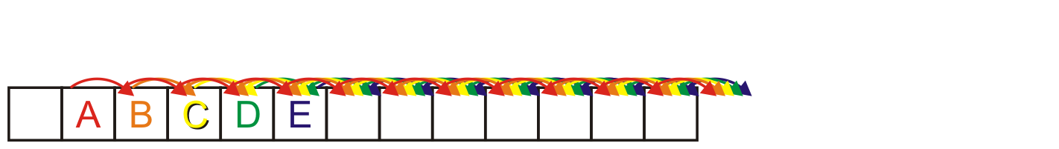
Background
Linear probing causes primary clustering
All entries follow the same search pattern for bins:
int initial = hash_M( x.hash(), M );
for ( int k = 0; k < M; ++k ) {
bin = (initial + k) % M;
// ...
}

Slide 5
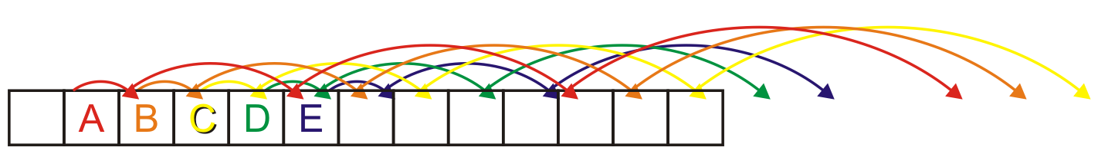
Background
This can be partially solved with quadratic probing
The step size grows in quadratic increments: 0, 1, 4, 9, 16, ...
int bin = hash_M( x.hash(), M );
for ( int k = 0; k < M; ++k ) {
bin = (bin + k) % M;
// ...
}
Problems: what happens if multiple things are placed in the same bin?
The same steps are followed for each: secondary clustering
This indicates a potentially poor hash function
This sometimes cannot be avoided

Slide 6
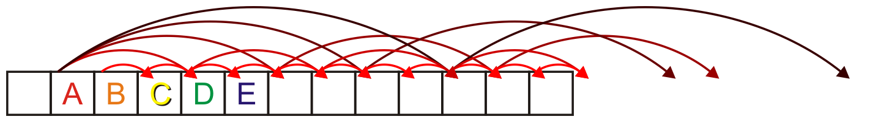
Background
An alternate solution?
Give each object (with high probability) a different jump size

Slide 7
Description
Associate with each object an initial bin and a jump size
For example,
int initial = hash_M( x.hash(), M );
int jump = hash2_M( x.hash(), M );
for ( int k = 0; k < M; ++k ) {
bin = (initial + k*jump) % M;
}

Slide 8
Description
Problem:
Will initial + k*jump step through all of the bins?
Here, the jump size is 7:
M = 16;
initial = 5
jump = 7;
for ( int k = 0; k <= M; ++k ) {
std::cout << (initial + k*jump) % M << ' ';
}
The output is
5 12 3 10 1 8 15 6 13 4 11 2 9 0 7 14 5

Slide 9
Description
Problem:
Will initial + k*jump step through all of the bins?
Now, the jump size is 12:
M = 16;
initial = 5
jump = 12;
for ( int k = 0; k <= M; ++k ) {
std::cout << (initial + k*jump) % M << ' ';
}
The output is now
5 1 13 9 5 1 13 9 5 1 13 9 5 1 13 9 5

Slide 10
Description
The jump size and the number of bins M must be coprime¹
They must share no common factors
There are two ways of ensuring this:
Make M a prime number
Restrict the prime factors
¹ also known as relatively prime

Slide 11
Making M Prime
If we make the table size M = p a prime number then all values between 1, ..., p – 1 are relatively prime
Example: 13 does not share any common factors with 1, 2, 3, ..., 11, 12
Problems:
All operations must be done using %
Cannot use &, <<, or >>
The modulus operator % is relatively slow
Doubling the number of bins is difficult:
What is the next prime after 2 × 263?

Slide 12
Using M = 2^{m}
We can restrict the number of prime factors
If we ensure M = 2^{m} then:
The only prime factor of M is 2
All odd numbers are relatively prime to M
Benefits:
Doubling the size of the array is easy
We can use bitwise operations

Slide 13
Using M = 2^{m}
Given a number, how do we ensure the jump size is odd?
Make the least-significant bit a 1:
unsigned int make_odd( unsigned int n ) {
return n | 1;
}
For example:
0010101101100100111100010101010?
|
00000000000000000000000000000001
=
00101011011001001111000101010101

Slide 14
Using M = 2^{m}
This also works for signed integers and 2’s complement:
The least significant bit of a negative odd number is 1
For example
–1 11111111111111111111111111111111
–2 11111111111111111111111111111110
–3 11111111111111111111111111111101
–4 11111111111111111111111111111100
–5 11111111111111111111111111111011
–6 11111111111111111111111111111010
–7 11111111111111111111111111111001
–8 11111111111111111111111111111000
–9 11111111111111111111111111110111

Slide 15
Using M = 2^{m}
Devising a second hash function is necessary
One solution: define two functions hash_M1 and hash_M2 which map onto 0, …, M – 1
Use a different set of m bits, e.g., if m = 10 use
00101001011011011111000100010101
. | 1
initial jump
where initial == 365 and jump == 965
Useful only if m ≤ 16

Slide 16
Using M = 2^{m}
Another solution:
int initial = hash_M( x.hash(), M );
int jump = hash_M( x.hash() * 532934959, M ) | 1;
for ( int k = 0; k < M; ++k ) {
bin = (initial + k*jump) & (M - 1);
// ...
}
532934959 is prime

Slide 17
Example
Consider a hash table with M = 16 bins
Given a 3-digit hexadecimal number:
The least-significant digit is the primary hash function (bin)
The next digit is the secondary hash function (jump size)
Example: for 6B72A₁₆ , the initial bin is A and the jump size is 3

Slide 18
Example
Insert these numbers into this initially empty hash table
19A, 207, 3AD, 488, 5BA, 680, 74C, 826, 946, ACD, B32, C8B, DBE, E9C
0 | 1 | 2 | 3 | 4 | 5 | 6 | 7 | 8 | 9 | A | B | C | D | E | F

Slide 19
Example
Start with the first four values:
19A, 207, 3AD, 488
0 | 1 | 2 | 3 | 4 | 5 | 6 | 7 | 8 | 9 | A | B | C | D | E | F

Slide 20
Example
Start with the first four values:
19A, 207, 3AD, 488
0 | 1 | 2 | 3 | 4 | 5 | 6 | 7 | 8 | 9 | A | B | C | D | E | F
 |  |  |  |  |  |  | 207 | 488 |  | 19A |  |  | 3AD

Slide 21
Example
Next we must insert 5BA
0 | 1 | 2 | 3 | 4 | 5 | 6 | 7 | 8 | 9 | A | B | C | D | E | F
 |  |  |  |  |  |  | 207 | 488 |  | 19A |  |  | 3AD

Slide 22
Example
Next we must insert 5BA
Bin A is occupied
The jump size is B is already odd
A jump size of B is equal to a jump size of B – 10₁₆ = –5
0 | 1 | 2 | 3 | 4 | 5 | 6 | 7 | 8 | 9 | A | B | C | D | E | F
 |  |  |  |  |  |  | 207 | 488 |  | 19A |  |  | 3AD

Slide 23
Example
Next we must insert 5BA
Bin A is occupied
The jump size is B is already odd
A jump size of B is equal to a jump size of B – 10₁₆ = –5
The sequence of bins is A, 5
0 | 1 | 2 | 3 | 4 | 5 | 6 | 7 | 8 | 9 | A | B | C | D | E | F
 |  |  |  |  | 5BA |  | 207 | 488 |  | 19A |  |  | 3AD

Slide 24
Example
Next we are adding 680, 74C, 826
0 | 1 | 2 | 3 | 4 | 5 | 6 | 7 | 8 | 9 | A | B | C | D | E | F
 |  |  |  |  | 5BA |  | 207 | 488 |  | 19A |  |  | 3AD

Slide 25
Example
Next we are adding 680, 74C, 826
All the bins are empty—simply insert them
0 | 1 | 2 | 3 | 4 | 5 | 6 | 7 | 8 | 9 | A | B | C | D | E | F
680 |  |  |  |  | 5BA | 826 | 207 | 488 |  | 19A |  | 74C | 3AD

Slide 26
Example
Next, we must insert 946
0 | 1 | 2 | 3 | 4 | 5 | 6 | 7 | 8 | 9 | A | B | C | D | E | F
680 |  |  |  |  | 5BA | 826 | 207 | 488 |  | 19A |  | 74C | 3AD

Slide 27
Example
Next, we must insert 946
Bin 6 is occupied
The second digit is 4, which is even
The jump size is 4 + 1 = 5
0 | 1 | 2 | 3 | 4 | 5 | 6 | 7 | 8 | 9 | A | B | C | D | E | F
680 |  |  |  |  | 5BA | 826 | 207 | 488 |  | 19A |  | 74C | 3AD

Slide 28
Example
Next, we must insert 946
Bin 6 is occupied
The second digit is 4, which is even
The jump size is 4 + 1 = 5
The sequence of bins is 6, B
0 | 1 | 2 | 3 | 4 | 5 | 6 | 7 | 8 | 9 | A | B | C | D | E | F
680 |  |  |  |  | 5BA | 826 | 207 | 488 |  | 19A | 946 | 74C | 3AD

Slide 29
Example
Next, we must insert ACD
0 | 1 | 2 | 3 | 4 | 5 | 6 | 7 | 8 | 9 | A | B | C | D | E | F
680 |  |  |  |  | 5BA | 826 | 207 | 488 |  | 19A | 946 | 74C | 3AD

Slide 30
Example
Next, we must insert ACD
Bin D is occupied
The jump size is C is even, so C + 1 = D is odd
A jump size of D is equal to a jump size of D – 10₁₆ = –3
0 | 1 | 2 | 3 | 4 | 5 | 6 | 7 | 8 | 9 | A | B | C | D | E | F
680 |  |  |  |  | 5BA | 826 | 207 | 488 |  | 19A | 946 | 74C | 3AD

Slide 31
Example
Next, we must insert ACD
Bin D is occupied
The jump size is C is even, so C + 1 = D is odd
A jump size of D is equal to a jump size of D – 10₁₆ = –3
The sequence of bins is D, A, 7, 4
0 | 1 | 2 | 3 | 4 | 5 | 6 | 7 | 8 | 9 | A | B | C | D | E | F
680 |  |  |  | ACD | 5BA | 826 | 207 | 488 |  | 19A | 946 | 74C | 3AD

Slide 32
Example
Next, we insert B32
0 | 1 | 2 | 3 | 4 | 5 | 6 | 7 | 8 | 9 | A | B | C | D | E | F
680 |  |  |  | ACD | 5BA | 826 | 207 | 488 |  | 19A | 946 | 74C | 3AD

Slide 33
Example
Next, we insert B32
Bin 2 is unoccupied
0 | 1 | 2 | 3 | 4 | 5 | 6 | 7 | 8 | 9 | A | B | C | D | E | F
680 |  | B32 |  | ACD | 5BA | 826 | 207 | 488 |  | 19A | 946 | 74C | 3AD

Slide 34
Example
Next, we insert C8B
0 | 1 | 2 | 3 | 4 | 5 | 6 | 7 | 8 | 9 | A | B | C | D | E | F
680 |  | B32 |  | ACD | 5BA | 826 | 207 | 488 |  | 19A | 946 | 74C | 3AD

Slide 35
Example
Next, we insert C8B
Bin B is occupied
The jump size is 8 is even, so 8 + 1 = 9 is odd
A jump size of 9 is equal to a jump size of 9 – 10₁₆ = –7
0 | 1 | 2 | 3 | 4 | 5 | 6 | 7 | 8 | 9 | A | B | C | D | E | F
680 |  | B32 |  | ACD | 5BA | 826 | 207 | 488 |  | 19A | 946 | 74C | 3AD

Slide 36
Example
Next, we insert C8B
Bin B is occupied
The jump size is 8 is even, so 8 + 1 = 9 is odd
A jump size of 9 is equal to a jump size of 9 – 10₁₆ = –7
The sequence of bins is B, 4, D, 6, F
0 | 1 | 2 | 3 | 4 | 5 | 6 | 7 | 8 | 9 | A | B | C | D | E | F
680 |  | B32 |  | ACD | 5BA | 826 | 207 | 488 |  | 19A | 946 | 74C | 3AD |  | C8B

Slide 37
Example
Inserting D59, we note that bin 9 is unoccupied
0 | 1 | 2 | 3 | 4 | 5 | 6 | 7 | 8 | 9 | A | B | C | D | E | F
680 |  | B32 |  | ACD | 5BA | 826 | 207 | 488 | D59 | 19A | 946 | 74C | 3AD |  | C8B

Slide 38
Example
Finally, insert E9C
0 | 1 | 2 | 3 | 4 | 5 | 6 | 7 | 8 | 9 | A | B | C | D | E | F
680 |  | B32 |  | ACD | 5BA | 826 | 207 | 488 | D59 | 19A | 946 | 74C | 3AD |  | C8B

Slide 39
Example
Finally, insert E9C
Bin C is occupied
The jump size is 9 is odd
A jump size of 9 is equal to a jump size of 9 – 10₁₆ = –7
0 | 1 | 2 | 3 | 4 | 5 | 6 | 7 | 8 | 9 | A | B | C | D | E | F
680 |  | B32 |  | ACD | 5BA | 826 | 207 | 488 | D59 | 19A | 946 | 74C | 3AD |  | C8B

Slide 40
Example
Finally, insert E9C
Bin C is occupied
The jump size is 9 is odd
A jump size of 9 is equal to a jump size of 9 – 10₁₆ = –7
The sequence of bins is C, 5, E
0 | 1 | 2 | 3 | 4 | 5 | 6 | 7 | 8 | 9 | A | B | C | D | E | F
680 |  | B32 |  | ACD | 5BA | 826 | 207 | 488 | D59 | 19A | 946 | 74C | 3AD | E9C | C8B

Slide 41
Example
Having completed these insertions:
The load factor is λ = 14/16 = 0.875
The average number of probes is 25/14 ≈ 1.79
0 | 1 | 2 | 3 | 4 | 5 | 6 | 7 | 8 | 9 | A | B | C | D | E | F
680 |  | B32 |  | ACD | 5BA | 826 | 207 | 488 | D59 | 19A | 946 | 74C | 3AD | E9C | C8B

Slide 42
Resizing the array
To double the capacity of the array, each value must be rehashed
680, B32, ACD, 5BA, 826, 207, 488, D59 may be immediately placed
We use the least-significant five bits for the initial bin
0 | 1 | 2 | 3 | 4 | 5 | 6 | 7 | 8 | 9 | A | B | C | D | E | F | 10 | 11 | 12 | 13 | 14 | 15 | 16 | 17 | 18 | 19 | 1A | 1B | 1C | 1D | 1E | 1F
680 |  |  |  |  |  | 826 | 207 | 488 |  |  |  |  | ACD |  |  |  |  | B32 |  |  |  |  |  |  | D59 | 5BA

Slide 43
Resizing the array
To double the capacity of the array, each value must be rehashed
19A resulted in a collision
The jump size is now 000110011010₂ or C + 1 = D = 13₁₀
We are using the next five bits for the jump size
The sequence of bins: 1A, 7, 14
0 | 1 | 2 | 3 | 4 | 5 | 6 | 7 | 8 | 9 | A | B | C | D | E | F | 10 | 11 | 12 | 13 | 14 | 15 | 16 | 17 | 18 | 19 | 1A | 1B | 1C | 1D | 1E | 1F
680 |  |  |  |  |  | 826 | 207 | 488 |  |  |  |  | ACD |  |  |  |  | B32 |  | 19A |  |  |  |  | D59 | 5BA

Slide 44
Resizing the array
To double the capacity of the array, each value must be rehashed
946 resulted in a collision
The jump size is now 100101000110₂ or A + 1 = B = 11₁₀
The sequence of bins: 6, 11
0 | 1 | 2 | 3 | 4 | 5 | 6 | 7 | 8 | 9 | A | B | C | D | E | F | 10 | 11 | 12 | 13 | 14 | 15 | 16 | 17 | 18 | 19 | 1A | 1B | 1C | 1D | 1E | 1F
680 |  |  |  |  |  | 826 | 207 | 488 |  |  |  |  | ACD |  |  |  | 946 | B32 |  | 19A |  |  |  |  | D59 | 5BA

Slide 45
Resizing the array
To double the capacity of the array, each value must be rehashed
74C fits into its bin
0 | 1 | 2 | 3 | 4 | 5 | 6 | 7 | 8 | 9 | A | B | C | D | E | F | 10 | 11 | 12 | 13 | 14 | 15 | 16 | 17 | 18 | 19 | 1A | 1B | 1C | 1D | 1E | 1F
680 |  |  |  |  |  | 826 | 207 | 488 |  |  |  | 74C | ACD |  |  |  | 946 | B32 |  | 19A |  |  |  |  | D59 | 5BA

Slide 46
Resizing the array
To double the capacity of the array, each value must be rehashed
3AD resulted in a collision
The jump size is now 001110101101₂ or 1D = 29₁₀ ≡ –3₁₀
The sequence of bins: D, A
32
0 | 1 | 2 | 3 | 4 | 5 | 6 | 7 | 8 | 9 | A | B | C | D | E | F | 10 | 11 | 12 | 13 | 14 | 15 | 16 | 17 | 18 | 19 | 1A | 1B | 1C | 1D | 1E | 1F
680 |  |  |  |  |  | 826 | 207 | 488 |  | 3AD |  | 74C | ACD |  |  |  | 946 | B32 |  | 19A |  |  |  |  | D59 | 5BA

Slide 47
Resizing the array
To double the capacity of the array, each value must be rehashed
Both E9C and C8B fit without a collision
The load factor is λ = 14/32 = 0.4375
The average number of probes is 18/14 ≈ 1.29
0 | 1 | 2 | 3 | 4 | 5 | 6 | 7 | 8 | 9 | A | B | C | D | E | F | 10 | 11 | 12 | 13 | 14 | 15 | 16 | 17 | 18 | 19 | 1A | 1B | 1C | 1D | 1E | 1F
680 |  |  |  |  |  | 826 | 207 | 488 |  | 3AD | C8B | 74C | ACD |  |  |  | 946 | B32 |  | 19A |  |  |  |  | D59 | 5BA |  | E9C

Slide 48
Erase
Can we remove an object like we did with linear probing?
Clearly, no, as there are M/2 possible locations where an object which could have occupied a position could be located
As with quadratic probing, we will use lazy deletion
Mark a bin as ERASED; however, when searching, treat the bin as occupied and continue
enum bin_state_t {
UNOCCUPIED,
OCCUPIED,
ERASED
};
bin_state_t state[M];
for ( int i = 0; i < M; ++i ) {
state[i] = UNOCCUPIED;
}

Slide 49
Erase
If we erase 3AD, we must mark that bin as erased
0 | 1 | 2 | 3 | 4 | 5 | 6 | 7 | 8 | 9 | A | B | C | D | E | F
680 |  | B32 |  | ACD | 5BA | 826 | 207 | 488 | 959 | 19A | 946 | 74C | 3AD | E9C | C8B

Slide 50
Find
When searching, it is necessary to skip over this bin
For example, find ACD: D, A, 7, 4
find C8B: B, 4, D, 6, F
0 | 1 | 2 | 3 | 4 | 5 | 6 | 7 | 8 | 9 | A | B | C | D | E | F
680 |  | B32 |  | ACD | 5BA | 826 | 207 | 488 | 959 | 19A | 946 | 74C | 3AD | E9C | C8B

Slide 51
Multiple insertions and erases
One problem which may occur after multiple insertions and removals is that numerous bins may be marked as ERASED
In calculating the load factor, an ERASED bin is equivalent to an OCCUPIED bin
This will increase our run times…

Slide 52
Multiple insertions and erases
We can easily track the number of bins which are:
UNOCCUPIED
OCCUPIED
ERASED
by updating appropriate counters
If the load factor λ grows too large, we have two choices:
If the load factor due to occupied bins is too large, double the table size
Otherwise, rehash all of the objects currently in the hash table

Slide 53
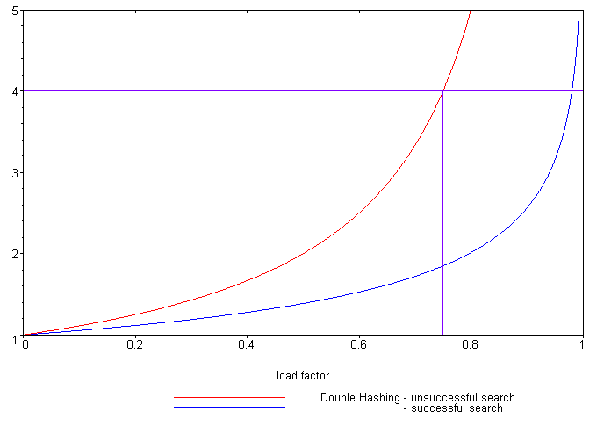
Expected number of probes
Load Factor (λ)
Unsuccessful search
Successful search
Reference: Knuth, The Art of Computer Programming,
Vol. 3, 2nd Ed., 1998, Addison Wesley, p. 530.
As with quadratic probing, the number of probes is significantly lower than for linear probing:
Successful searches:
Unsuccessful searches:
When λ = 2/3, we requires 1.65 and 3 probes, respectively
Linear probing required 3 and 5 probes, respectively

Slide 54
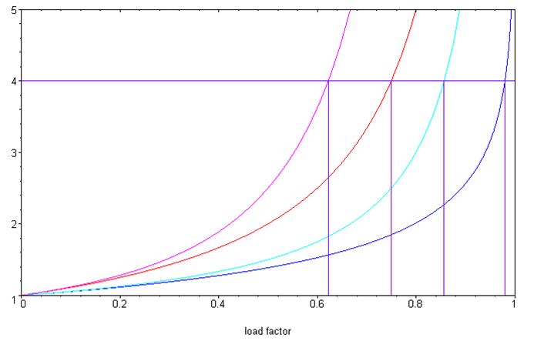
Double hashing versus linear probing
Comparing the two:
Linear probing
Unsuccessful search
Successful search
Double hashing
Unsuccessful search
Successful search
Examined Bins
Load Factor (λ)

Slide 55
Cache misses
Double hashing solves the secondary clustering problem
Unfortunately, each subsequent probe could be anywhere in the array
For large arrays, it is unlikely that block is in the cache
This will flag a cache miss and another page will be copied to the cache
This is slower than quadratic probing
It may also remove another page from the cache that is to be called again soon in the future
If a change was made to the page in the cache, it must be copied out
When at all possible, use quadratic probing

Slide 56
Summary
In this topic, we have looked at double hashing:
An open addressing technique
Uses two hash functions:
The first indicates the bin
The second gives the jump size
Insertions and searching are straight forward
Removing objects is more complicated: use lazy deletion
It may be useful, on occasion, to clean the table
Much worse than quadratic probing with respect to cache misses

Slide 57
References
Wikipedia, http://en.wikipedia.org/wiki/Hash_function
[1] Cormen, Leiserson, and Rivest, Introduction to Algorithms, McGraw Hill, 1990.
[2] Weiss, Data Structures and Algorithm Analysis in C++, 3rd Ed., Addison Wesley.
These slides are provided for the ECE 250 Algorithms and Data Structures course. The material in it reflects Douglas W. Harder’s best judgment in light of the information available to him at the time of preparation. Any reliance on these course slides by any party for any other purpose are the responsibility of such parties. Douglas W. Harder accepts no responsibility for damages, if any, suffered by any party as a result of decisions made or actions based on these course slides for any other purpose than that for which it was intended.

